Slide 1
Dual coding – revise the plot of An Inspector Calls by labelling each event below. Stuck? Try this Video link to help you.
Additional task: cut these cards out and shuffle them to test yourself of the order.

Slide 2
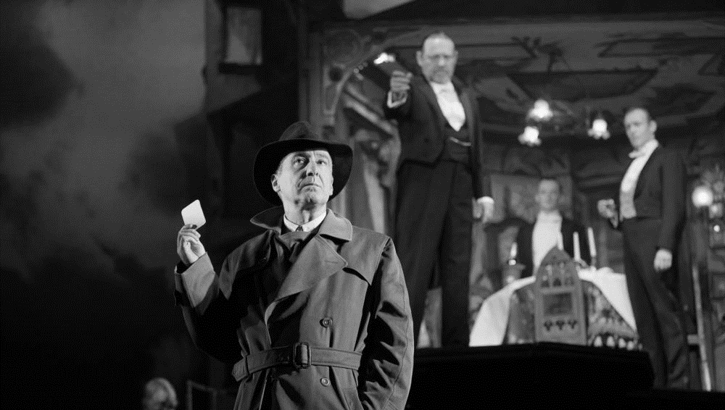
The central message of the play – An Inspector Calls
By reminding the audience about the inequalities and limitations of life for ‘millions and millions’ of people in 1912, and by hinting at the devastating conflicts to come, Priestley emphasises the importance of working together for greater social change. In this sense, the central message of the play is both a warning and a call for further action: a warning about the consequences of selfishness and a call to continue campaigning for a fairer and more socially responsible society. Remember that the Labour Party was elected in 1945 and the leader, Clement Attlee, made a pledge to provide welfare to all British citizens who needed it. In this this sense – despite the grizzly events that unfold on stage – the play is actually very optimistic.
Research questions:
Why was AIC set in 1912 and written in 1945? You can research your answer
What is a Socialist?
What is a Capitalist?
Who can we apply these terms to in AIC?
Use the link below to secure your understanding of the plot and context of AIC:
https://www.bbc.co.uk/bitesize/guides/z27p9qt/revision/1
A Reminder of Inequalities and Limitations in 1912
Why is the role of Edna important?
Why are the names Eva Smith and Daisy Renton significant?
Why is the suicide of Eva Smith described (twice) in such graphic detail?
Why is it significant that Eva Smith is unable to find employment immediately after getting fired?
Why is the character of Alderman Meggarty significant?
What ‘capital’ do the Birlings possess other than financial wealth?
What is Birling’s immediate concern after the Inspector leaves?
A Call for Further Action in 1946
Why does the stage lighting change when the Inspector enters?
Why is the name Inspector Goole significant?
How does Priestley emphasise that the Inspector is a credible character (i.e. not a ‘crank’)?
What does the Inspector mean when he says ‘we are members of one body’?
What is the meaning of the reference the Inspector makes to ‘fire and blood and anguish’?
Does it matter if the Inspector is a ‘fake’?
What does it mean when people describe the Inspector as ‘Priestley’s mouthpiece’?
There are film versions of all of your literature texts – why not watch one to help you revise? Here’s a free one on Youtube for AIC:
https://www.youtube.com/watch?v=zXT0FgfrQWM

