Slide 1
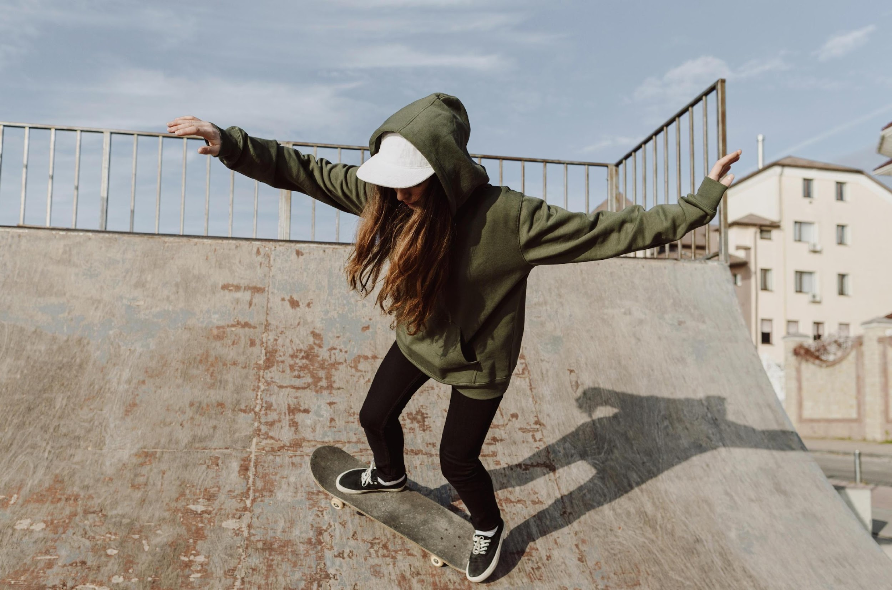




Slide 2
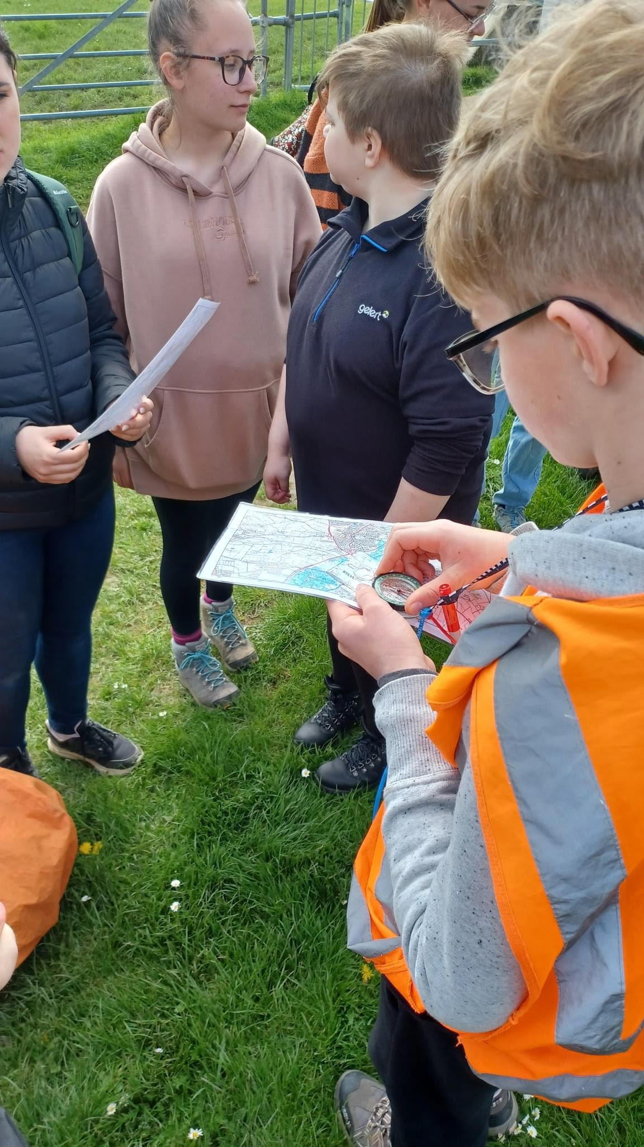

What is the DofE?
The DofE is a life-changing adventure.
It empowers young people to build essential life and work skills. It encourages personal growth, resilience, and confidence
Millions of young people in the UK have already done their DofE.
Now it’s your turn.
Notes:
The DofE is a life-changing adventure which will help you develop the skills you need for your future life and work. ​
The DofE gives you the chance to discover just how much you’re capable of.
It’s a great way to meet new people, try new things, do what you love and make a difference in your community.

Slide 3
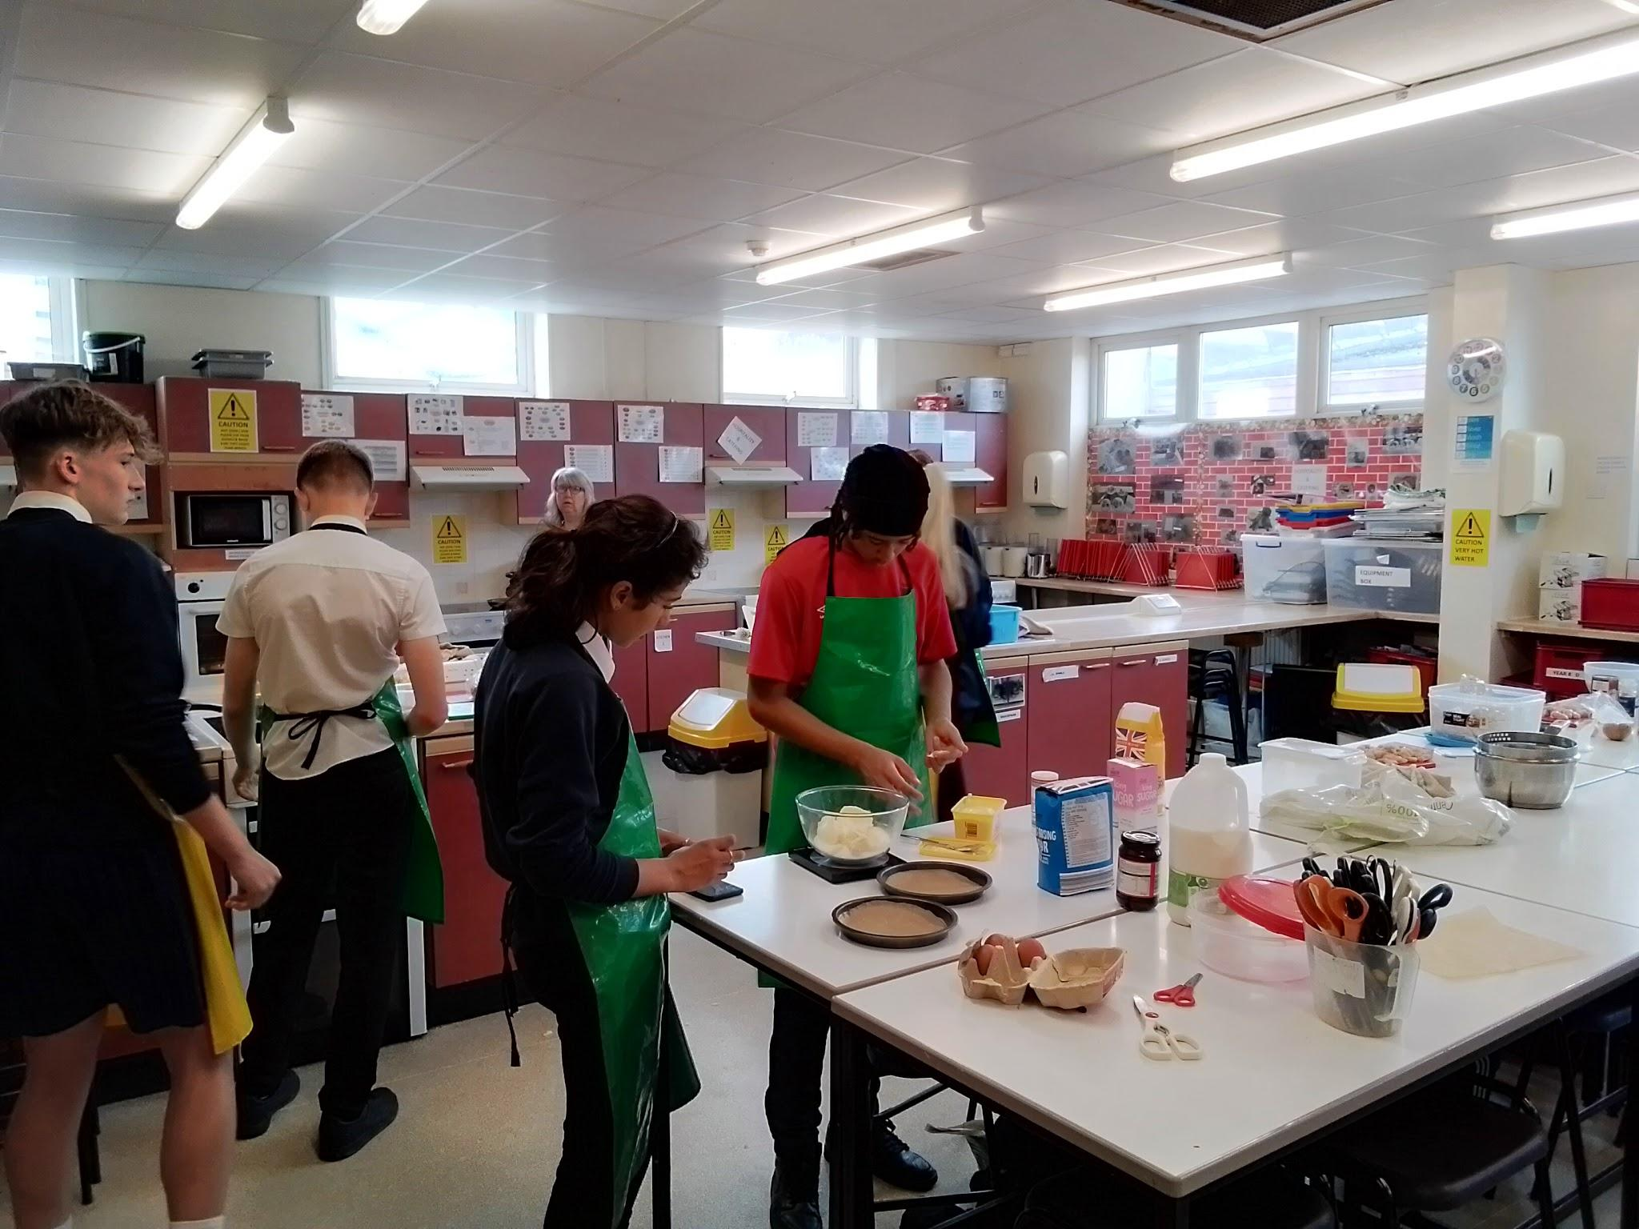
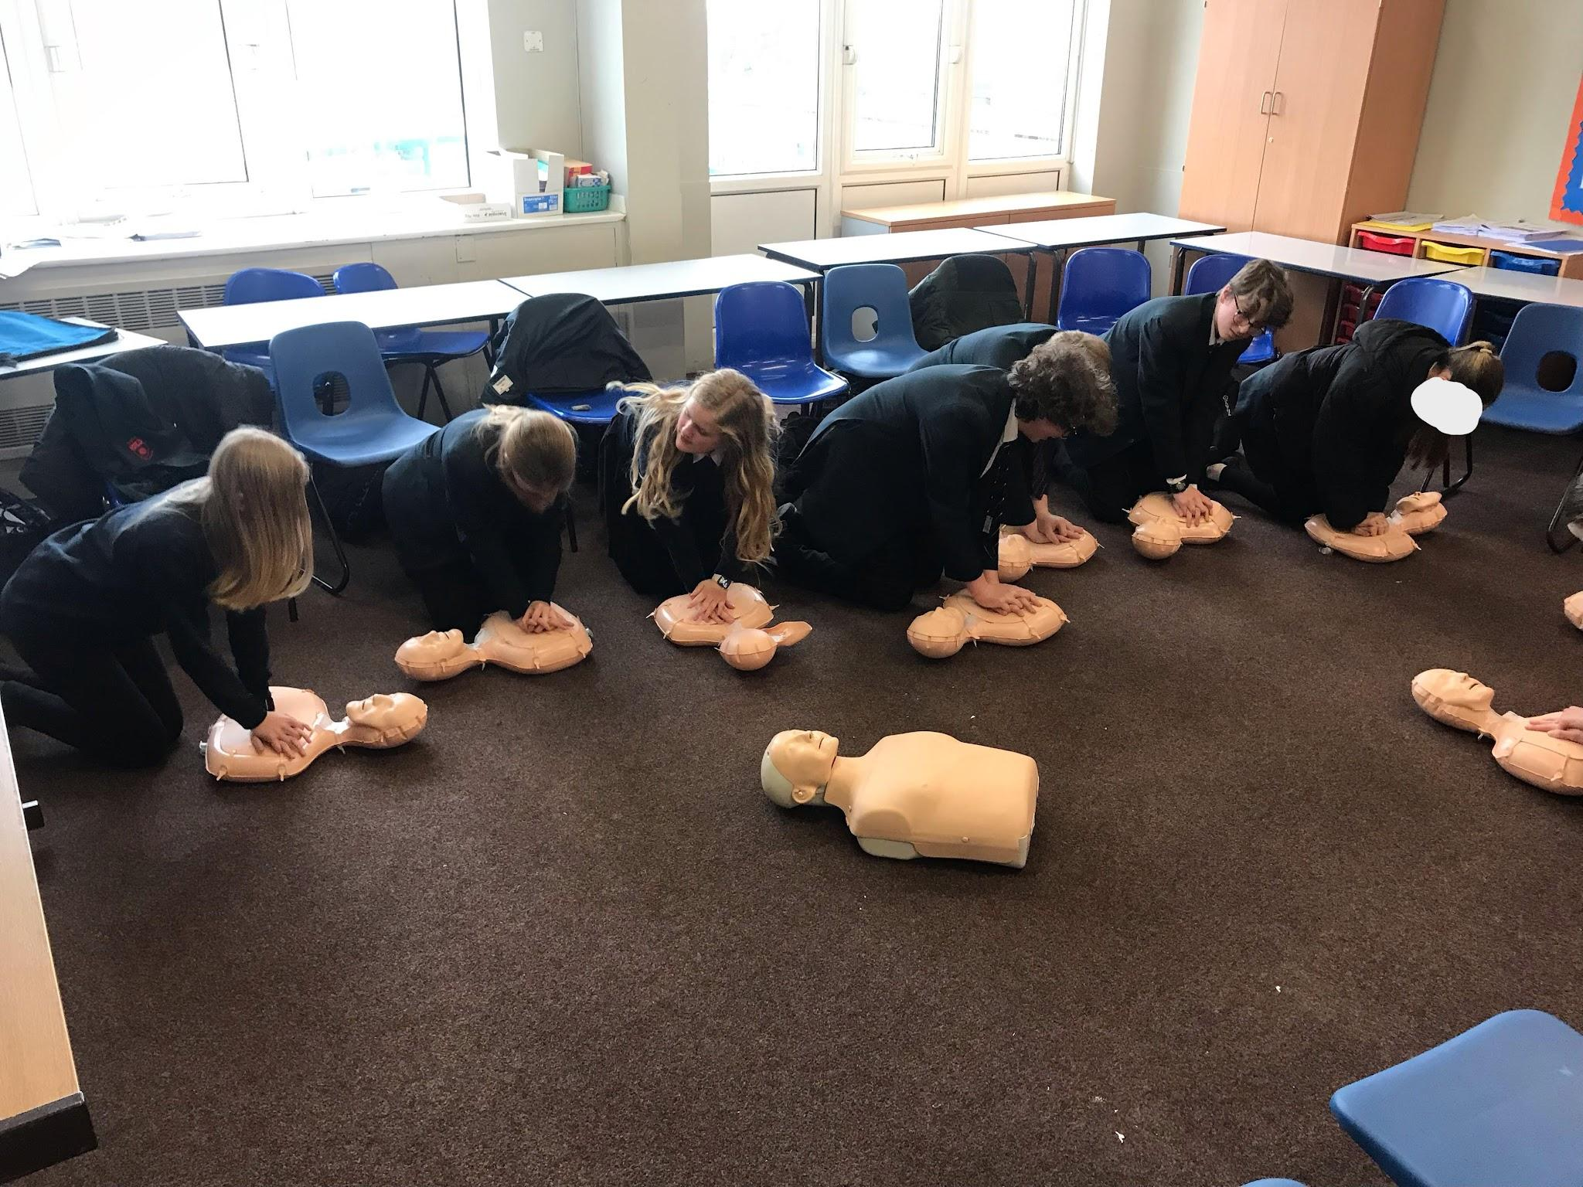
What are the benefits?
Extra qualification
College, University or job
Interviews
Life experiences
New skills
Resilience

Slide 4

Introducing the DofE
Notes:
The following film provides an overview of the Duke of Edinburgh's Award.

Slide 5
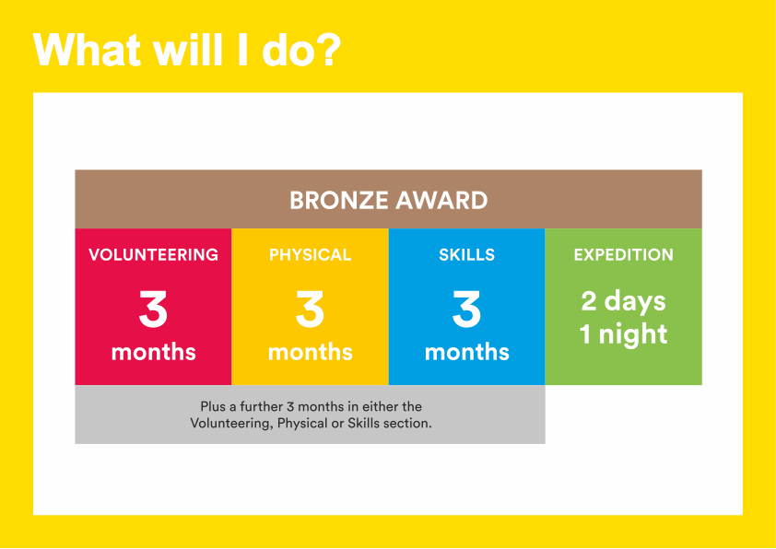
1 hour per week
Notes:
To achieve your DofE Bronze Award, you will need to complete four sections – Volunteering, Physical activity, developing a skill and the Expedition.​
Activities for each section take a minimum of one hour a week, so they can easily fit in around your studies and other interests.​
You will need to spend at least 3 months completing each of the Volunteering, Physical and Skills sections.
You will also need to decide which one of these you would like to do for six months.​
You will need to keep a record of the time you spend on each activity.
You should ask somebody who has a good understanding of the activity you have chosen to write a report describing what you have done.​
It may seem daunting at first but remember that most activities can count towards your DofE.
I will now describe each section of the award in more detail.

Slide 6
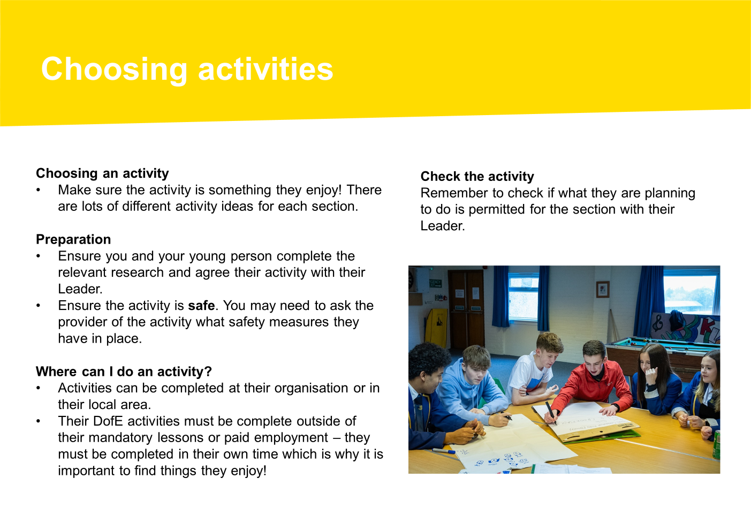
Notes:
To achieve your DofE Bronze Award, you will need to complete four sections – Volunteering, Physical activity, developing a skill and the Expedition.​
Activities for each section take a minimum of one hour a week, so they can easily fit in around your studies and other interests.​
You will need to spend at least 3 months completing each of the Volunteering, Physical and Skills sections.
You will also need to decide which one of these you would like to do for six months.​
You will need to keep a record of the time you spend on each activity.
You should ask somebody who has a good understanding of the activity you have chosen to write a report describing what you have done.​
It may seem daunting at first but remember that most activities can count towards your DofE.
I will now describe each section of the award in more detail.

Slide 7
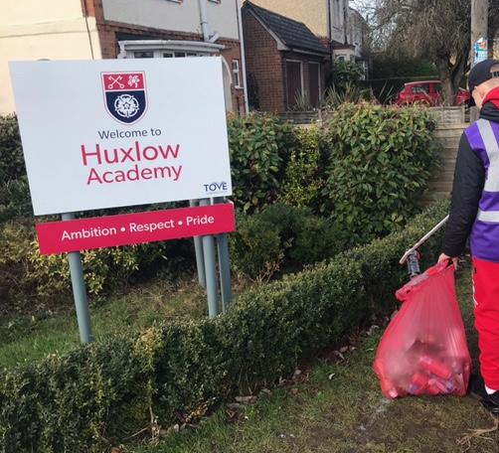


Volunteering section
Take action and make a difference to the causes you care about
Help others and change things for the better
https://www.dofe.org/do/volunteering/
Notes:
As part of your Bronze DofE Award, you will need to donate some of your time to volunteering.​
Volunteering is a chance to help other people, and to make a difference to the causes you feel most passionate about.​
As well as changing things for the better, lots of young people find that volunteering is a great way to increase their confidence and gain new skills.​
Examples of volunteering could be coaching a local football team, collecting items for a foodbank or campaigning for change on issues you feel passionate about
Presenter: Feel free to include a broad range of examples here and to talk about what previous participants have done.
You can choose to volunteer in any area you would like – the only rule is that you must not be doing a job that companies would normally pay somebody for.​

Slide 8
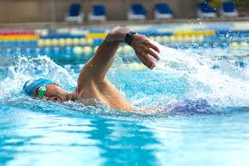



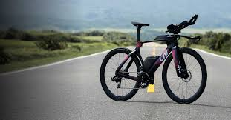
Physical section
Take part in whatever
dance, sport or ﬁtness
activity you would like.
Improving your health and fitness and having fun along the way!
https://www.dofe.org/do/physical/
Notes:
To complete the Physical section of your Bronze Award, you will have the opportunity to take part in regular physical activity.
Becoming more active can be a huge amount of fun, and it can also help you feel happier and healthier.
Almost any dance, sport or fitness activity can count — it’s completely up to you which activities you choose.
You may decide to join a team or to do something on your own.
You may like to try something completely different, or to concentrate and improve on an activity you already do.
​

Slide 9

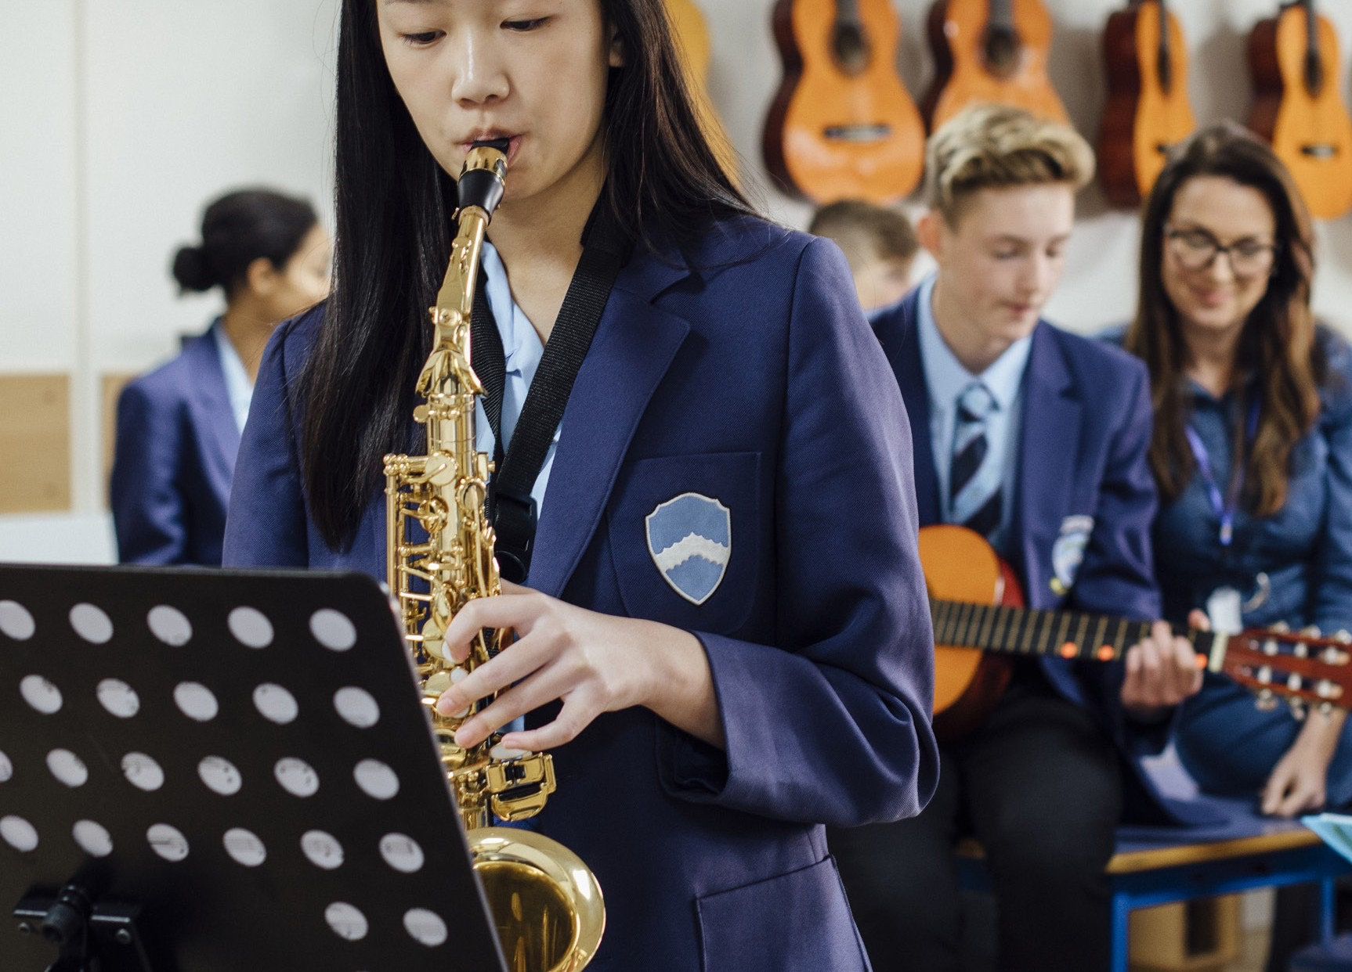
Skills section
Developing existing skills or discovering new things to love.
https://www.dofe.org/do/skills/
Notes:
Through the Skills section, you will be encouraged to develop your practical and social skills in an area you can choose.
You can decide whether you will try to get better at something you already feel passionate about, or learn to do something new.
In the past, young people have done a huge range of different activities for their skills section, such as computer coding, driving and cooking.
Presenter: Please add in your own examples here.
Gaining new interests and talents is a huge amount of fun and lots of young people also feel a real sense of achievement from doing it.
​

Slide 10
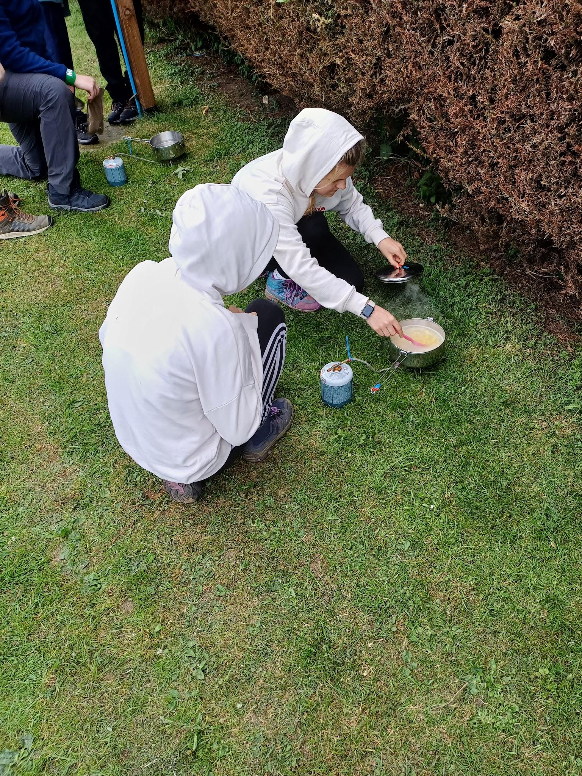
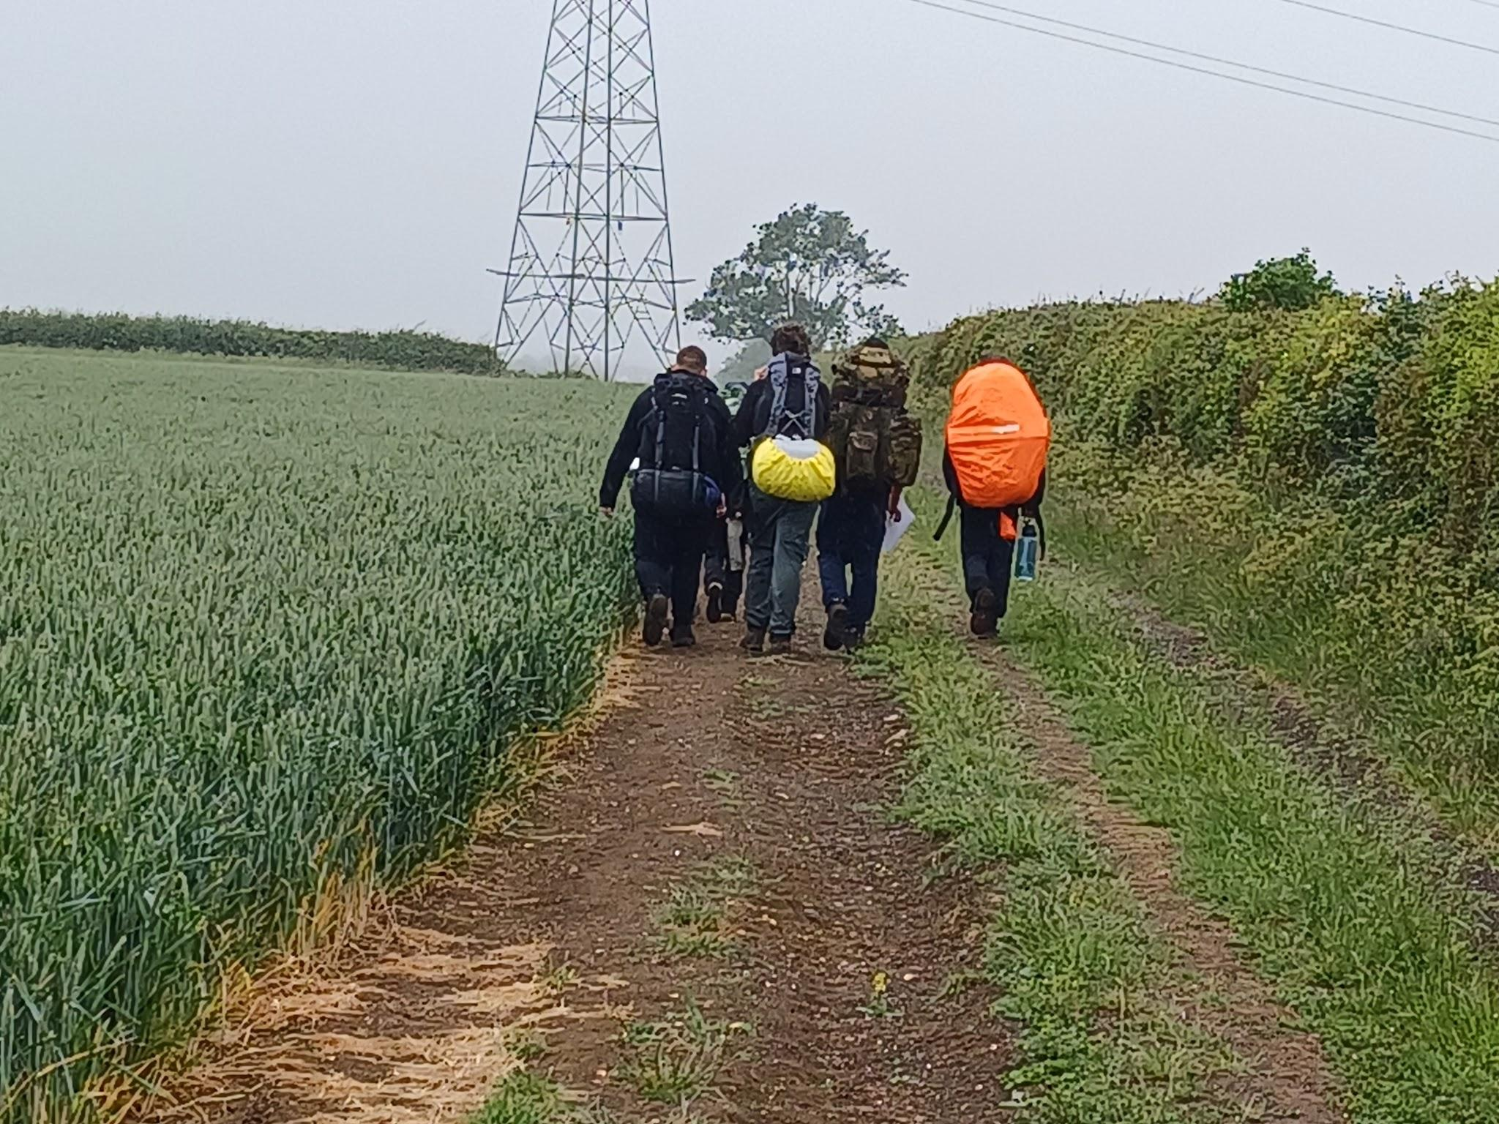
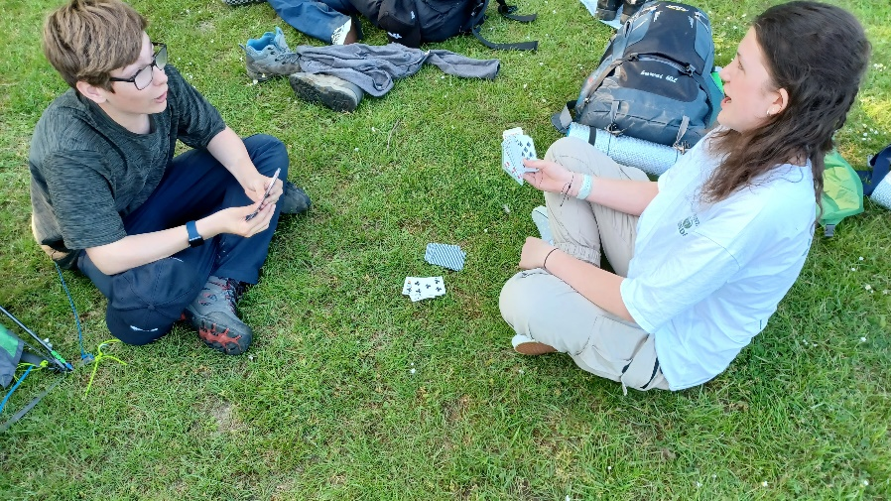
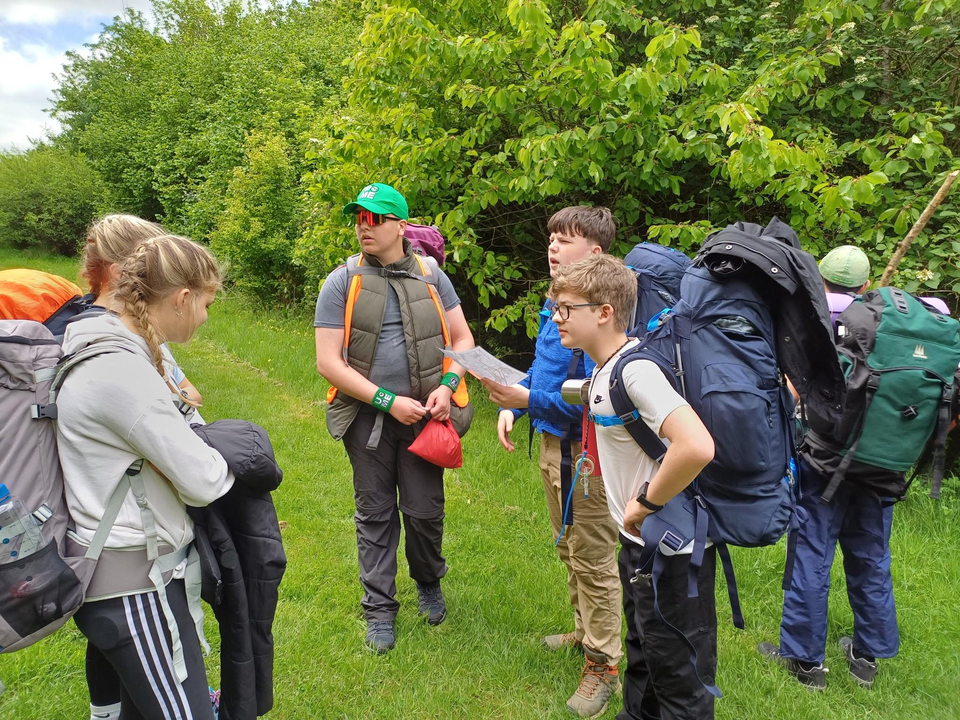
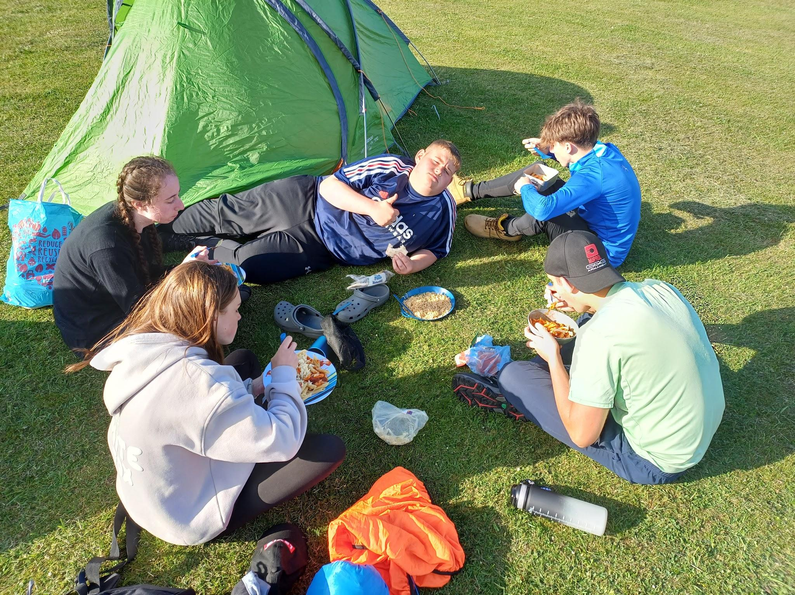
Expedition
Explore the great outdoors and spend a night away from home
Create memories that will last a lifetime
Notes:
The final section of your Bronze DofE Award is the Expedition.​
​As part of a small team, you’ll plan your aim, choose your location and do some training to make sure you’re prepared and know what you’re doing — then spend two days and one night away.​
​You can choose how you want to travel – it doesn’t have to be on foot. You could do it by bike, canoe, kayak, wheelchair, sailing boat or even on a horse.​
​Your Expedition will improve your resilience, communication, teamwork and leadership skills. ​
​Presenter: Please take care to place the same level of emphasis on each of the four sections. Whilst some young people may be attracted to the DofE because of the expedition, we know that some young people find this element daunting, so may need careful reassurance.
​

Slide 11

www.dofe.org
Visit our website for the most up-to-date information and guidance.

Slide 12
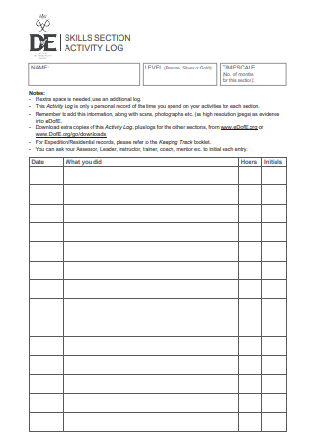
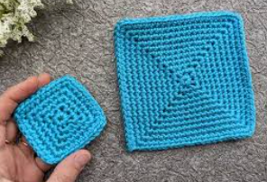
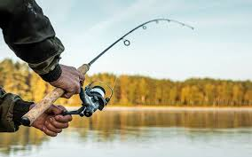

How to record your session
Notes:
Once you have signed up to do your DofE, you will receive a Welcome Pack in the post which contains lots of useful information and advice. ​
​You will also get your own eDofE account so that you can plan your activities online using the free DofE app.​
​You will also receive a DofE Card which will give you and your family money off in several shops selling the sorts of equipment you may need.​

Slide 13
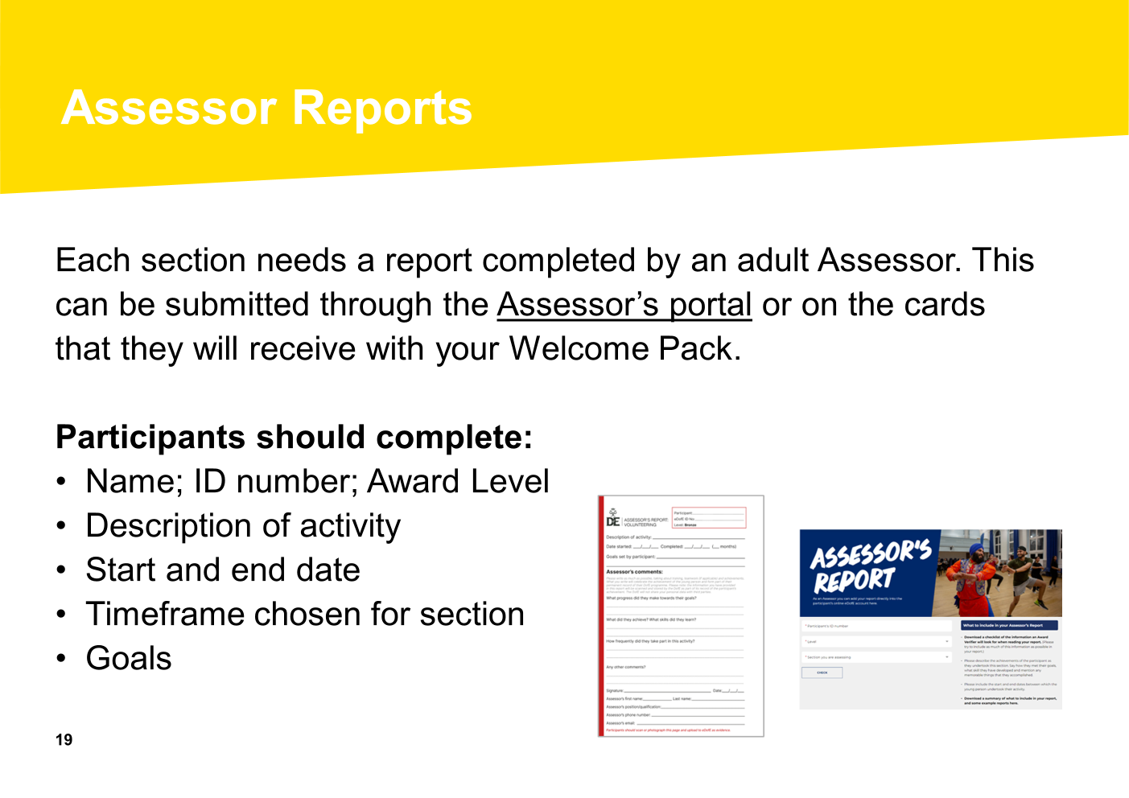

Notes:
Once you have signed up to do your DofE, you will receive a Welcome Pack in the post which contains lots of useful information and advice. ​
​You will also get your own eDofE account so that you can plan your activities online using the free DofE app.​
​You will also receive a DofE Card which will give you and your family money off in several shops selling the sorts of equipment you may need.​

Slide 14
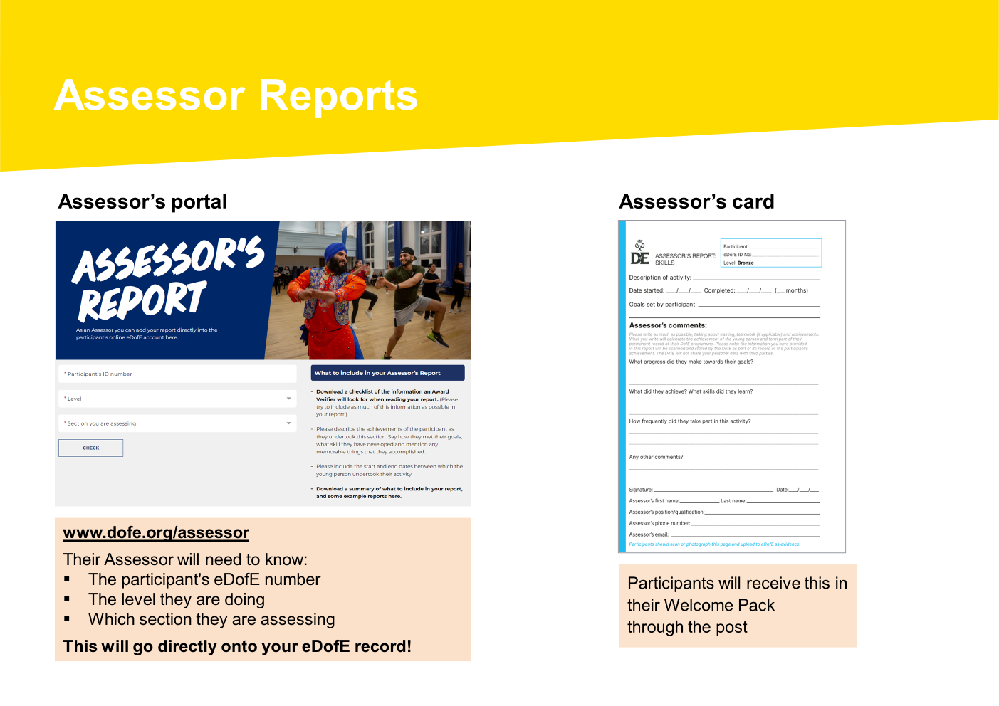

Slide 15


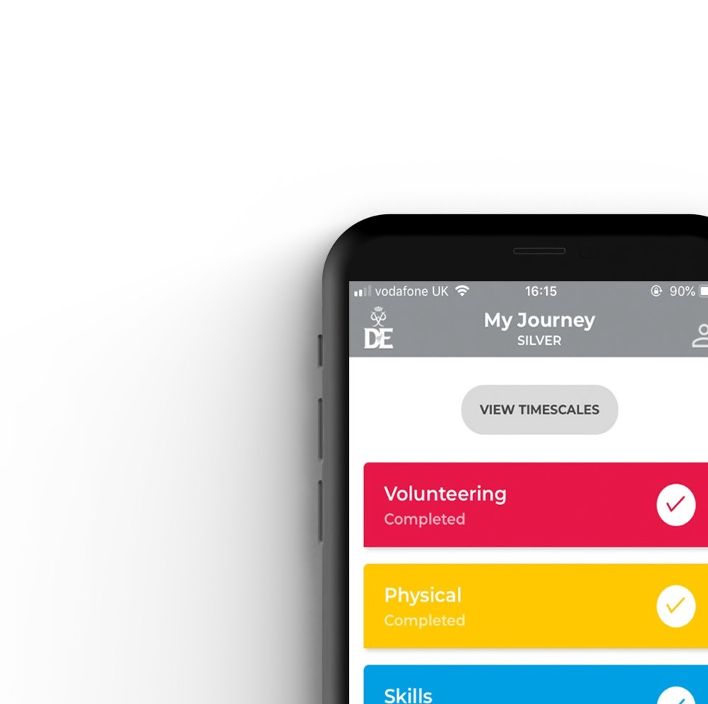

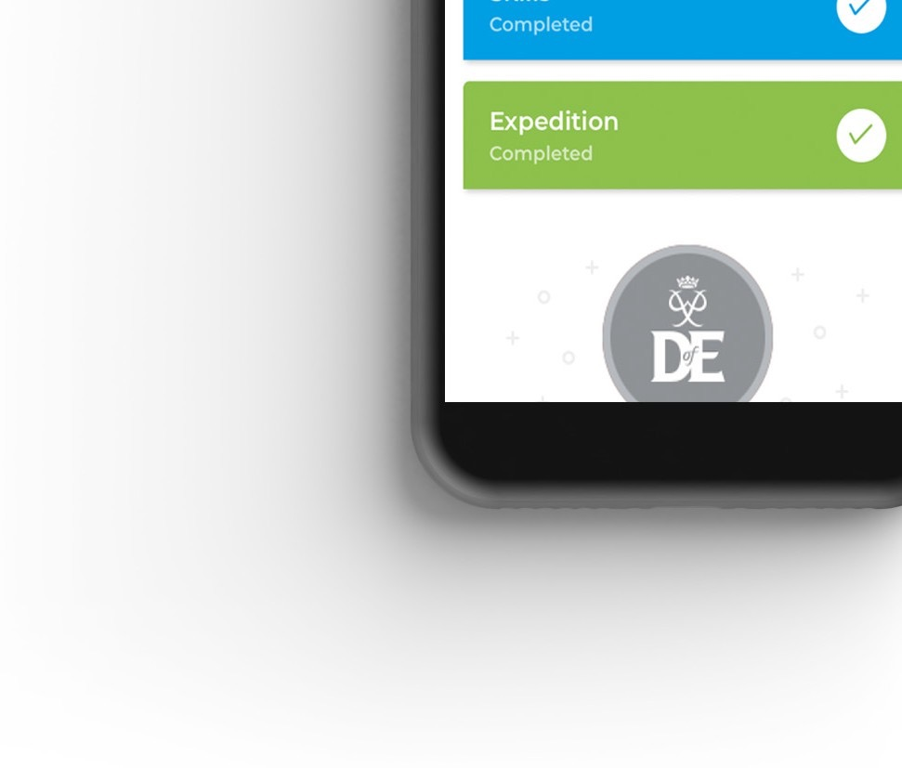
Your Welcome Pack and eDofE
Notes:
Once you have signed up to do your DofE, you will receive a Welcome Pack in the post which contains lots of useful information and advice. ​
​You will also get your own eDofE account so that you can plan your activities online using the free DofE app.​
​You will also receive a DofE Card which will give you and your family money off in several shops selling the sorts of equipment you may need.​

Slide 16
Lunch club
Mrs Sandison will hold a lunchclub every other week starting in February to prepare for the expedition.
There will also be a drop in session every Thursday lunchtime for anyone who needs some support.
Notes:
Once you have signed up to do your DofE, you will receive a Welcome Pack in the post which contains lots of useful information and advice. ​
​You will also get your own eDofE account so that you can plan your activities online using the free DofE app.​
​You will also receive a DofE Card which will give you and your family money off in several shops selling the sorts of equipment you may need.​

Slide 17
Bronze Cohort
I made it!
It was really fun!
I didn't think I could do it but I did!
It was so hard - but so worth it.
It made something I normally do even better.
Bronze done. Bring on Silver!
An extremely exiting opportunity that is well worth the effort
We had so much fun. It was a great experience
It was a great experience that you can only have once
A unique experience that will help your future later in life
Notes:
The final section of your Bronze DofE Award is the Expedition.​
​As part of a small team, you’ll plan your aim, choose your location and do some training to make sure you’re prepared and know what you’re doing — then spend two days and one night away.​
​You can choose how you want to travel – it doesn’t have to be on foot. You could do it by bike, canoe, kayak, wheelchair, sailing boat or even on a horse.​
​Your Expedition will improve your resilience, communication, teamwork and leadership skills. ​
​Presenter: Please take care to place the same level of emphasis on each of the four sections. Whilst some young people may be attracted to the DofE because of the expedition, we know that some young people find this element daunting, so may need careful reassurance.
​

Slide 18
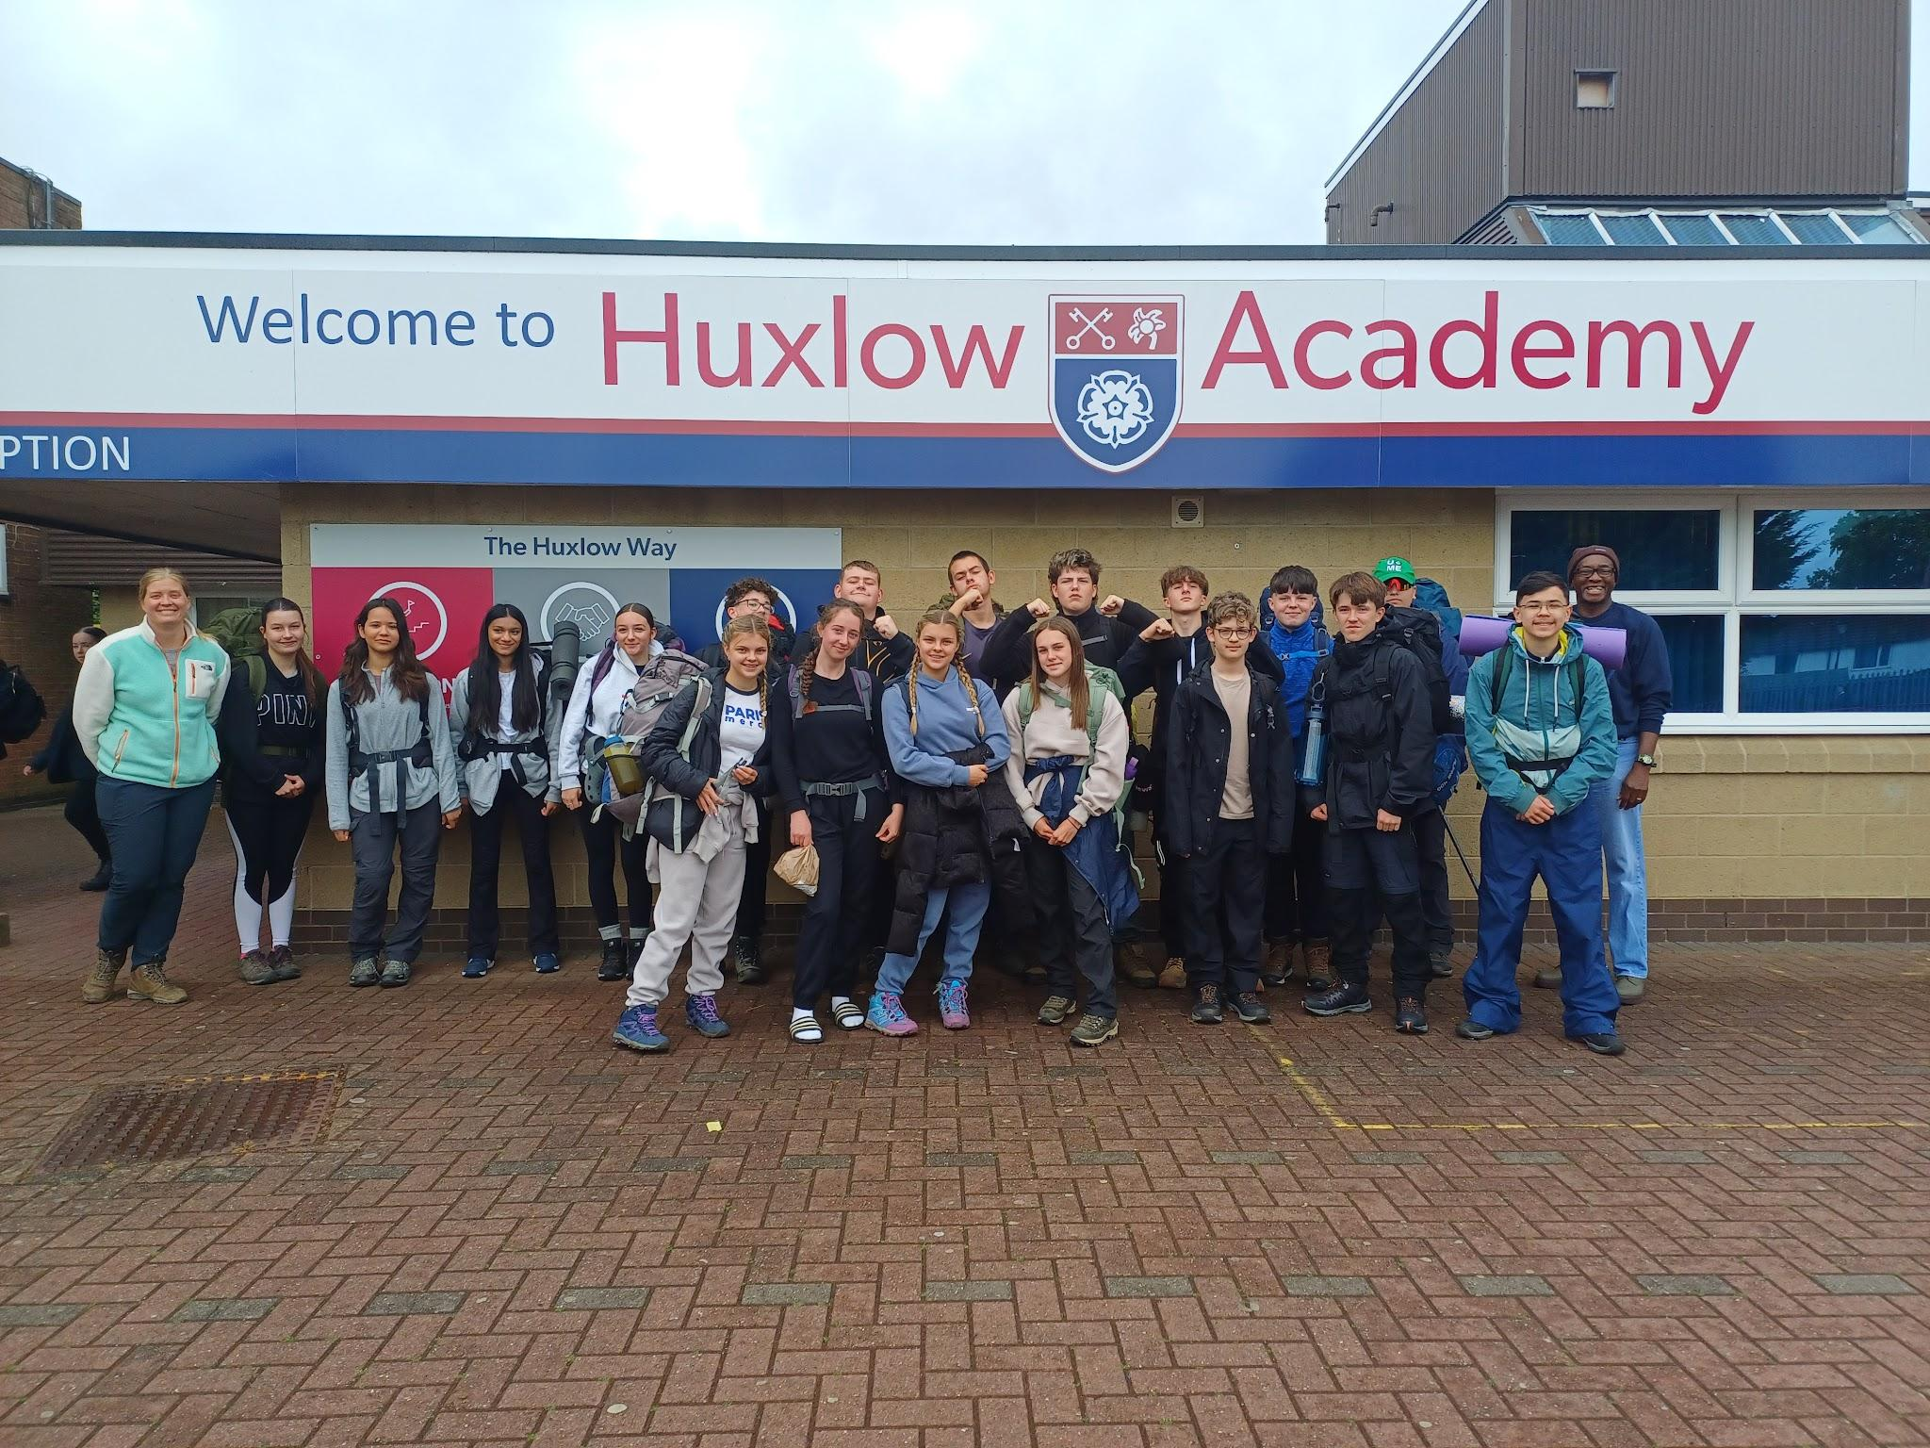
Getting started
Are you ready to start an adventure you’ll never forget?
To get started with your DofE,
speak to Mrs Sandison or Mr Venn.
Ashley Sandison
DofE Manager
In this bit goes some words you’ve written about yourself. Be positive and tell us who you are? What you’ve done... though don’t tell us your A Level results, there’s plenty of other forms for that. And what excites you about the DofE. You can go on for quite a bit... well, as long as it ﬁlls this box and then suddenly your words will get cut off, even if you’re in the middle of
The DofE is a charity. Visit DofE.org for more information.
Notes:
Presenter: Please customise this slide with the contact details of your DofE leader/administrator.
​Explain the next steps.
​Outline your organisation’s process for signing up to DofE.​
​
​

