Slide 1
Growing People
September 2019
Paul Thompson
Employers and Skills Manager
South East Midlands
Labour Market Information

Slide 2
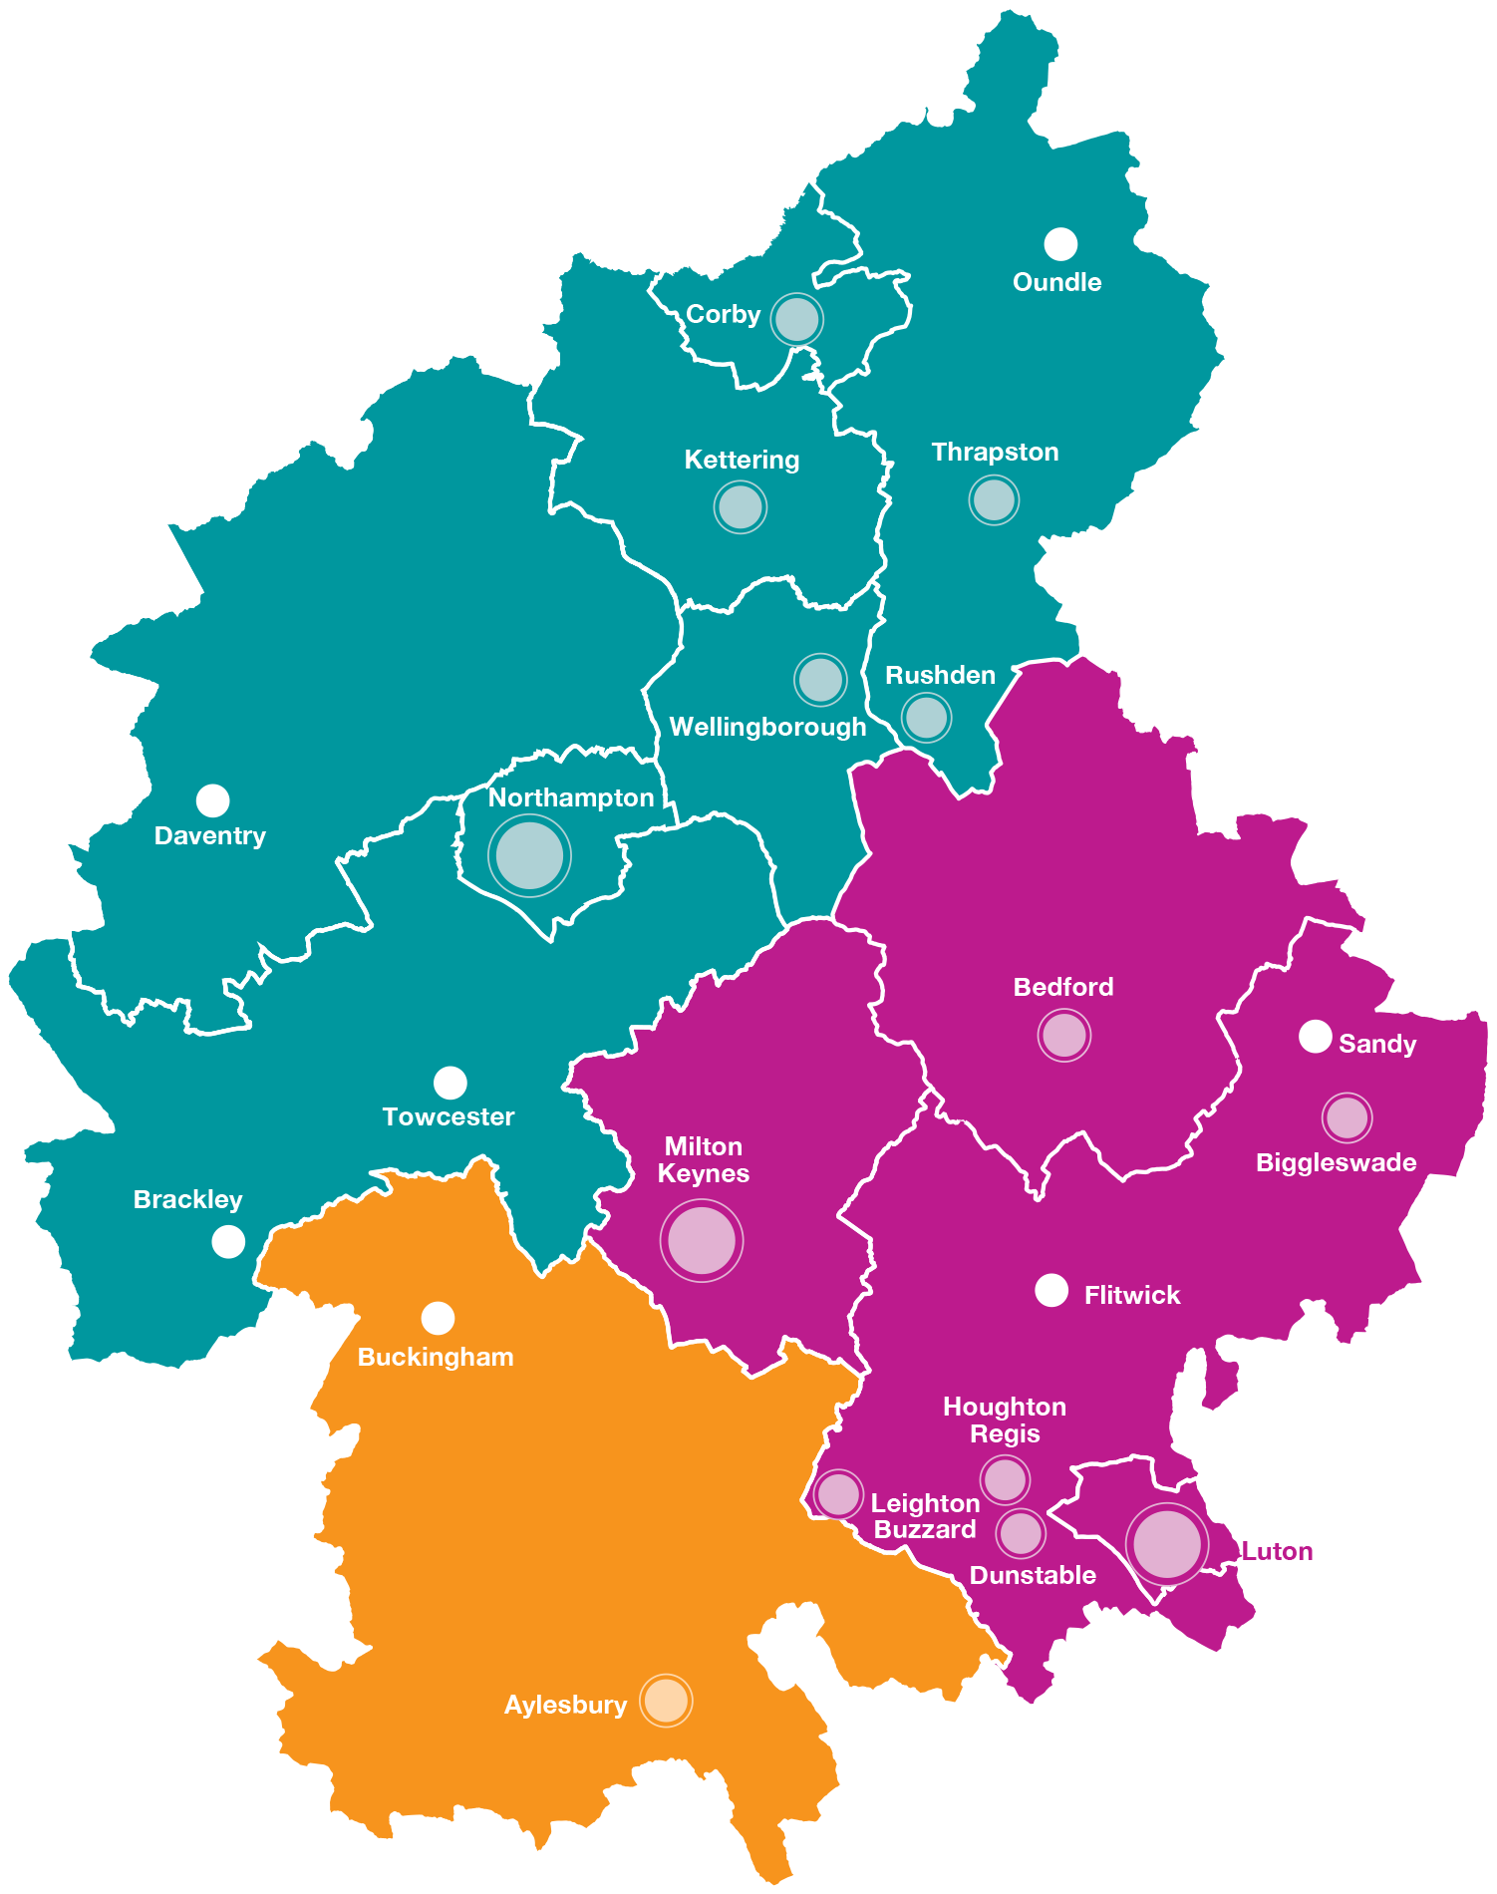
South East Midlands
95,000 business units
£52bn economy
916,000employed
Most innovative businesses in England
High number of new businesses

Slide 3
Employment
High proportion of skilled occupations
Source: Annual population survey ONS from Nomis on 20/9/19
Notes:
The need for people with skills and skilled trades continues to rise in the South-East Midlands.
Currently professional and skilled trades make up 55% of employment in the South-East Midlands and other skilled occupations account for 24%, both with continued growth.
Lower skilled occupations make up the balance of 21% with a negative trend.
(Note: Dotted lines are linear trends and not predictions)
Source: ONS Population Survey
August 2017

Slide 4
Businesses
97% of Businesses are Micro or Small
Source: UK Business Counts - local units by industry and employment size band
ONS from Nomis on 20/9/19
Notes:
The need for people with skills and skilled trades continues to rise in the South-East Midlands.
Currently professional and skilled trades make up 55% of employment in the South-East Midlands and other skilled occupations account for 24%, both with continued growth.
Lower skilled occupations make up the balance of 21% with a negative trend.
(Note: Dotted lines are linear trends and not predictions)
Source: ONS Population Survey
August 2017

Slide 5
Where are the Job Vacancies?
Source: Labour Insight 19/9/19
Notes:
The need for people with skills and skilled trades continues to rise in the South-East Midlands.
Currently professional and skilled trades make up 55% of employment in the South-East Midlands and other skilled occupations account for 24%, both with continued growth.
Lower skilled occupations make up the balance of 21% with a negative trend.
(Note: Dotted lines are linear trends and not predictions)
Source: ONS Population Survey
August 2017

Slide 6
What Occupations are Employers Seeking?
Source: Labour Insight 19/9/19
Notes:
The need for people with skills and skilled trades continues to rise in the South-East Midlands.
Currently professional and skilled trades make up 55% of employment in the South-East Midlands and other skilled occupations account for 24%, both with continued growth.
Lower skilled occupations make up the balance of 21% with a negative trend.
(Note: Dotted lines are linear trends and not predictions)
Source: ONS Population Survey
August 2017

Slide 7
What Occupations are Employers Seeking?
Source: Labour Insight 19/9/19
Notes:
The need for people with skills and skilled trades continues to rise in the South-East Midlands.
Currently professional and skilled trades make up 55% of employment in the South-East Midlands and other skilled occupations account for 24%, both with continued growth.
Lower skilled occupations make up the balance of 21% with a negative trend.
(Note: Dotted lines are linear trends and not predictions)
Source: ONS Population Survey
August 2017

Slide 8
Where are the Opportunities Increasing?
Occupation Groupings | Last 365 Days 19/9/2019
Business Management and Operations | 17,547
Health Care including Nursing | 14,435
Sales | 13,941
Education and Training | 12,343
Information Technology/Digital | 12,316
Finance | 11,312
Engineering | 11,036
Clerical and Administrative | 10,002
Hospitality, Food, and Tourism | 7,963
Transportation/Logistics | 7,219
Manufacturing and Production | 6,958
Maintenance, Repair, and Installation | 6,905
Customer and Client Support | 6,082
Construction, Extraction, and Architecture | 5,430
Human Resources | 4,875
Law, Compliance, and Public Safety | 4,754
Planning and Analysis | 4,153
Community and Social Services | 4,137
Marketing and Public Relations | 2,860
Design, Media, and Writing | 2,379
Science and Research | 832
Personal Services | 744
Agriculture, Horticulture, & the Outdoors | 520
Performing Arts | 66
Increasing as a proportion of the total
Health Care including Nursing
Education and Training
Hospitality, Food, and Tourism
Transportation/logistics
Manufacturing and Production
Maintenance, Repair, and Installation
Customer and Client Support
Construction, Extraction, Architecture
Law, Compliance, and Public Safety
Source: Labour Insight 19/9/19
Notes:
The need for people with skills and skilled trades continues to rise in the South-East Midlands.
Currently professional and skilled trades make up 55% of employment in the South-East Midlands and other skilled occupations account for 24%, both with continued growth.
Lower skilled occupations make up the balance of 21% with a negative trend.
(Note: Dotted lines are linear trends and not predictions)
Source: ONS Population Survey
August 2017

Slide 9
What Employability Skills are Employers Seeking?
More emphasis being placed on behaviours, attitudes, core competencies and technical/vocational skills of the individual, defined as:
Basic Skills
Numeracy
Literacy
Core Competencies
Communication
Problem solving
Resilience
Initiative
Organisation
Teamwork
Digital literacy
Creativity
Attitudes & Behaviours
Work ethic
Curiosity
Independence
Reflective
Honesty
Reliability
Politeness
Humility
Technical/Vocational Skills
Job specific
Technical and practical
Higher digital skills
Customer relationships

Slide 10
What Basic Skills and Core Competencies are Employers Currently Seeking in their Own Words?
Basic Skill/Core Competency | Last 365 Days
Communication Skills | 40,128
Organisational Skills | 17,914
Teamwork / Collaboration | 15,585
Detail-Orientated | 14,905
Microsoft Excel | 14,634
Planning | 14,239
Creativity | 10,069
English | 9,281
Problem Solving | 9,127
Microsoft Office | 8,227
Building Effective Relationships | 7,344
Leadership | 7,299
Writing | 7,174
Basic Skill/Core Competency | Last 365 Days
Computer Literacy | 6,636
Research | 5,440
People Management | 5,413
Time Management | 5,027
Meeting Deadlines | 4,819
Multi-Tasking | 3,653
Verbal / Oral Communication | 3,381
Microsoft Word | 3,228
Presentation Skills | 3,198
Positive Disposition | 2,863
Written Communication | 2,827
Microsoft PowerPoint | 2,751
18% of Job Postings ask for Communication Skills
Source: Labour Insight 19/9/19

Slide 11
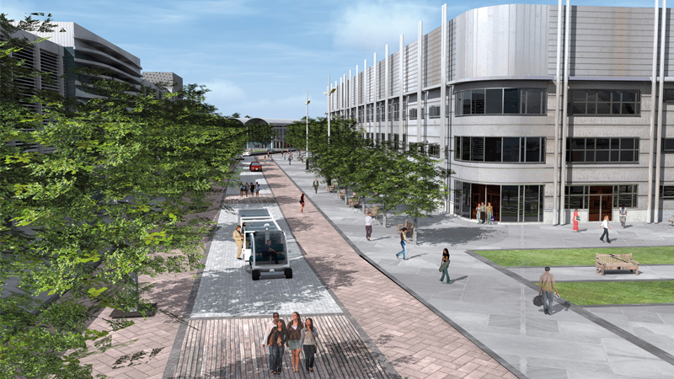
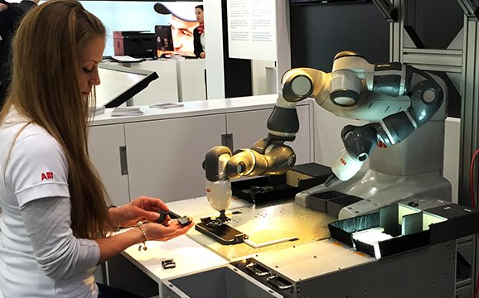
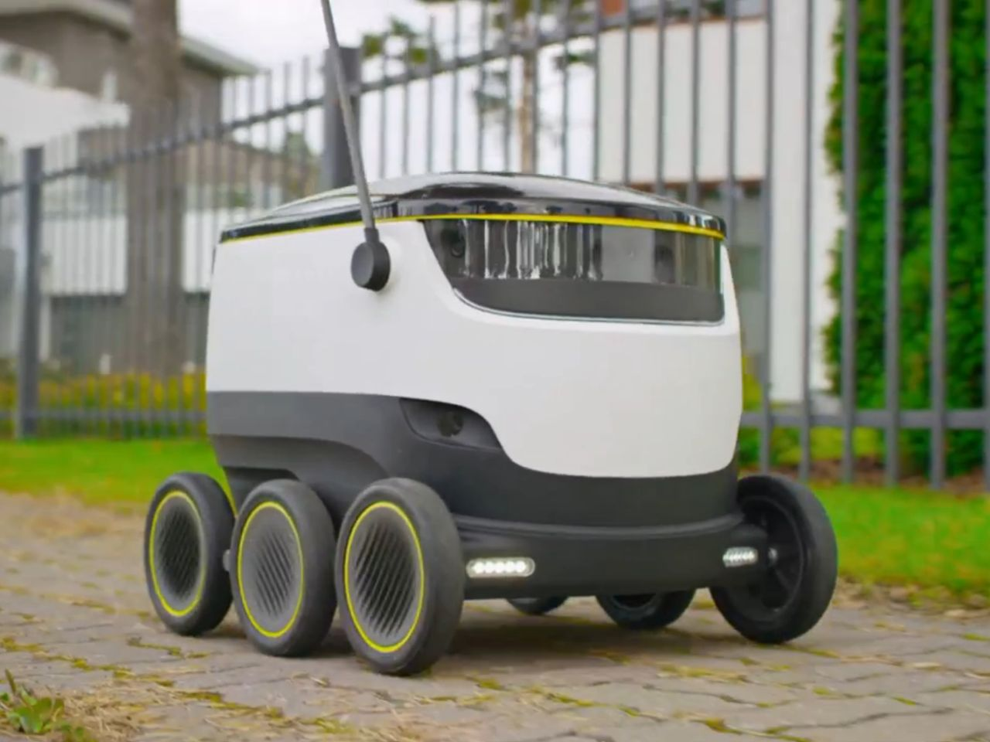
The Impact of Digital Technologies
Biggest impact on future skills is digital
‘The fourth industrial revolution’
Artificial Intelligence
Big Data
Cyber Security
Machine Learning
Internet of Things
Autonomous vehicles and intelligent mobility
Collaborative Robots
Delivery Bots
Notes:
Looking at them individually.
High Performance Technology has a number of elements.
The Automotive sector includes
‘Motorsport Valley’ – F1 teams including Red Bull and Mercedes, Silverstone, Rockingham Santa Pod
Auto Manufacturers/Design – Vauxhall, Nissan, Aston Martin, Brahms electric
Sales/Marketing HQs – Suzuki, Mercedes , VW Financial, Ducati, etc.
Motor Vehicle Components – SKF, Prodrive, TTI Group, etc.
Armoured Vehicles – Lockheed Martin
Testing – Millbrook,

Slide 12
Employers are Seeking People with Digital Skills Now
Digital Literacy (Core Competence)
Digital skills for both life and work. Main application is around the use of spreadsheets, word processing and presentation software, along with personal and business data protection. This can also include business systems (Enterprise Resource Planning (ERP)) and project management software.
Specialist Digital Skills (Technical/Vocational Skills)
Relate to specific digital jobs and are generally higher level than general digital skills. They could include:
Programming – use of programming languages such as Java, SQL, C#, etc.
Computer/network support – set up, maintenance, management of systems
Data analysis –use of Big Data/Data science.
Digital design –including graphic design, online advertising, digital production
Customer Relationship Management (CRM)
Digital marketing – use of social media platforms/analytical tools
Manufacturing technology – Computer-Aided Design (CAD)/Computer Numerical Control (CNC) programming software used in design, production and machining
Cyber security
Notes:
The activity to support enabling and re-engagement into work, together with re-skilling and up-skilling, will be primarily supported through the European Social Fund with an estimated value of £27m.
This will include:
Access to employment for unemployed individuals who are furthest away from the job market allowing them to tackle barriers to work and enter sustainable employment
Holistic Support to young people to be work ready for NEET and pre-NEET. This includes lone parents and carers. Particular focus on those who have a disability
Active inclusion for those more distant from the labour market, facing multiple complex barriers to gain or progress within employment. This cohort include the homeless, ex-offenders, troubled families, re-engagement of those needing mental well being support, long-term unemployed and parent returners
Access to lifelong learning to improve skills for those in work, especially those at risk due to skill deficiencies. Pre-qualification initiatives for individuals that have low literacy levels, work with SME’s around individual CPD, support employed individuals with a disability or mental health issue to access support and support for over 50’s to develop skills
Improving labour markets relevance of training and educations systems through employer participation and engagement by providing training from level 2-3 upwards developing innovative brokerage models focusing on engagement, providing the training and recruitment of apprenticeship assessors at all levels, building capacity for SMEs to help understand the benefits and opportunities of apprenticeship, internship and work placement programmes and champion support for self-employment and skills development for SME owners especially for women and entrepreneurs from BAME communities.
Particular focus on:
female and BAME participation
SME engagement
Construction and health and social care sectors
Rural communities

Slide 13
The Need for Digital Skills in Vacancies
Source: Labour Insight 19/9/19
Notes:
The need for people with skills and skilled trades continues to rise in the South-East Midlands.
Currently professional and skilled trades make up 55% of employment in the South-East Midlands and other skilled occupations account for 24%, both with continued growth.
Lower skilled occupations make up the balance of 21% with a negative trend.
(Note: Dotted lines are linear trends and not predictions)
Source: ONS Population Survey
August 2017

Slide 14
Vacancies and Future ‘Risk’ of Automation
Occupation | Number of Job Postings | Risk of Automation
Sales related occupations | 6,050 | Medium Risk
Customer service occupations | 5,530 | Medium Risk
Other administrative occupations | 5,152 | High Risk
Nurses | 4,370 | Low Risk
Programmers and software development professionals | 4,028 | Low Risk
Managers and proprietors in other services | 3,888 | Low Risk
Large goods vehicle drivers | 3,778 | Medium Risk
Elementary storage occupations | 3,422 | Medium Risk
Care workers and home carers | 3,320 | Medium Risk
Human resources and industrial relations officers | 3,169 | Low Risk
Secondary education teaching professionals | 2,925 | Low Risk
Engineering technicians | 2,924 | Low Risk
Book-keepers, payroll managers and wages clerks | 2,879 | High Risk
Marketing and sales directors | 2,637 | Low Risk
Chartered and certified accountants | 2,374 | High Risk
Van drivers | 2,317 | Medium Risk
IT business analysts, architects and systems designers | 2,254 | Low Risk
Teaching and other educational professionals | 2,130 | Low Risk
IT user support technicians | 2,078 | Medium Risk
Marketing associate professionals | 1,978 | Low Risk
Source: Labour Insight 19/9/19
Notes:
The need for people with skills and skilled trades continues to rise in the South-East Midlands.
Currently professional and skilled trades make up 55% of employment in the South-East Midlands and other skilled occupations account for 24%, both with continued growth.
Lower skilled occupations make up the balance of 21% with a negative trend.
(Note: Dotted lines are linear trends and not predictions)
Source: ONS Population Survey
August 2017

Slide 15
What Technical/Vocational Skills are Employers Seeking?
Customer Service/Contact Appears in over 20% of Job Postings
Source: Labour Insight 19/9/19
Notes:
The need for people with skills and skilled trades continues to rise in the South-East Midlands.
Currently professional and skilled trades make up 55% of employment in the South-East Midlands and other skilled occupations account for 24%, both with continued growth.
Lower skilled occupations make up the balance of 21% with a negative trend.
(Note: Dotted lines are linear trends and not predictions)
Source: ONS Population Survey
August 2017

Slide 16
Pathways
Vocational/Technical/ T-Level
Higher
Education
Employment & Career
+19
Vocational/
Technical/ T-Level
A-Level
Study
Programme
+16
GCSE
Vocational
No ‘better’ or ‘worse’ pathway just the relevant route for a career
14-16

Slide 17
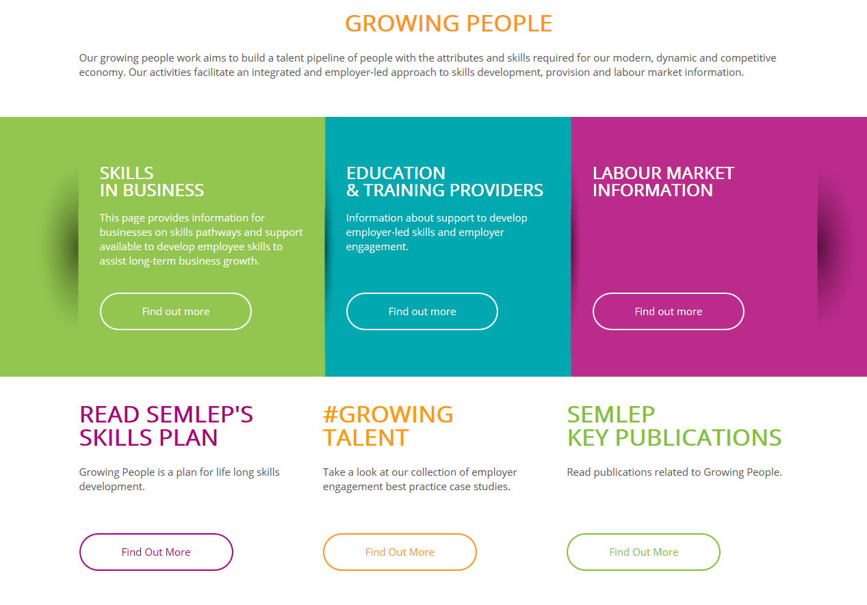
More Information
www.semlep.com
Notes:
The activity to support enabling and re-engagement into work, together with re-skilling and up-skilling, will be primarily supported through the European Social Fund with an estimated value of £27m.
This will include:
Access to employment for unemployed individuals who are furthest away from the job market allowing them to tackle barriers to work and enter sustainable employment
Holistic Support to young people to be work ready for NEET and pre-NEET. This includes lone parents and carers. Particular focus on those who have a disability
Active inclusion for those more distant from the labour market, facing multiple complex barriers to gain or progress within employment. This cohort include the homeless, ex-offenders, troubled families, re-engagement of those needing mental well being support, long-term unemployed and parent returners
Access to lifelong learning to improve skills for those in work, especially those at risk due to skill deficiencies. Pre-qualification initiatives for individuals that have low literacy levels, work with SME’s around individual CPD, support employed individuals with a disability or mental health issue to access support and support for over 50’s to develop skills
Improving labour markets relevance of training and educations systems through employer participation and engagement by providing training from level 2-3 upwards developing innovative brokerage models focusing on engagement, providing the training and recruitment of apprenticeship assessors at all levels, building capacity for SMEs to help understand the benefits and opportunities of apprenticeship, internship and work placement programmes and champion support for self-employment and skills development for SME owners especially for women and entrepreneurs from BAME communities.
Particular focus on:
female and BAME participation
SME engagement
Construction and health and social care sectors
Rural communities

